Slide 1
Signaling Pathways Produced By Combining DsRNA with Paclitaxal to treat Ovarian Cancer
Switu Patel

Slide 2
Ovarian Cancer
Epithelial ovarian cancer is ranked fifth among the malignant deaths of women in the United States
Cause is unknown, but one source of it can be invasive transformation of secretory cells in the fallopian tube
Common therapy: cytoreductive surgery followed by chemotherapy.

Slide 3
Dual Treatments
In Van et al. they combined Double stranded RNA (DsRNA) with therapeutic agents like paclitaxel and carboplatin to get a significant decrease in cell viability
DsRNA is known to stop the immunosuppression signals caused by ovarian tumor cells and activate four innate immune receptors
Notes:
The four receptors are: TLR3 ( L. et al., 2001), RIG-I (M. et al., 2004), mda5 ( Kang et al., 2002) and PKR ( Levin and London 1978). When stimulated, these receptors activate signaling pathways which lead to proinflammatory and apoptotic responses (Van et al., 2012).

Slide 4
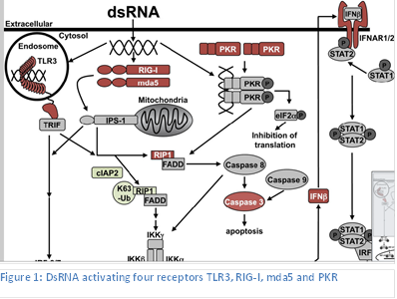

Slide 5
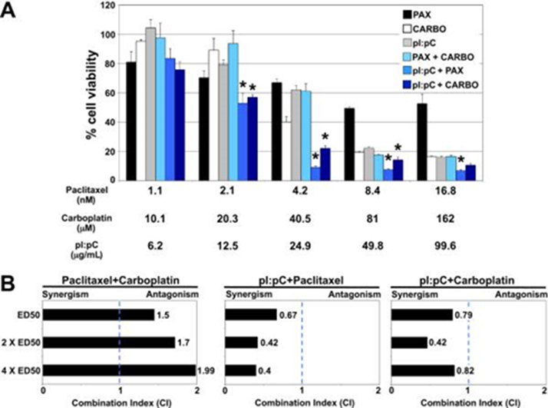
A- shows that the combined treatments cause a decrease in cell viability
B- Shows the synergistic effect of dsRNA (polyinosinic:polycytidylic acid) and paclitaxel
Notes:
This Figure shows that the individual treatments: paclitaxel, carboplatin, and dsRNA have a higher cell viability. While the started combined treatments: Paclitaxel + Carboplatin, dsRNA + Paclitaxel, and dsRNA + Carboplatin, cause a decrease in cell viability which indicates cell death. Statistically, at four treatment concentrations, cell viability was significantly decreased with dsRNA and pactlitaxel whereas at three treatment concentrations, cell viability was significantly decreased with the combination of dsRNA and carboplatin. This indicates that dsRNA paired with paclitaxel causes significant decrease in cell viability.

Slide 6
My Proposal
Previous studies have shown that the combination of dsRNA and paclitaxel causes synergistic cell death in ovarian cancer, however the mechanism by which this increased cell death occurs is unknown.
This proposal
Identify essential pathways of the apoptotic mechanisms necessary to induce this drug combination’s synergistic effect.
These signaling pathways will serve as biomarkers for individual patients
Notes:
We propose that these two therapeutic agents combined will induce overlapping signaling pathways that amplify activation of the extrinsic and intrinsic cell death cascades.

Slide 7
Experiment
Apoptotic PCR Array
For untreated, dsRNA, Paclitaxel and dsRNA + Paclitaxel combined treatment in the dsRNA sensitive cell line, OVCAR3.
Notes:
The goal of this experiment is to examine apoptotic signaling pathways that contribute to the synergistic decrease in cell viability observed with the combination of dsRNA and paclitaxel. To accomplish it a PCR Array will be performed.

Slide 8
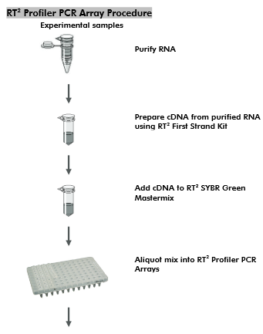
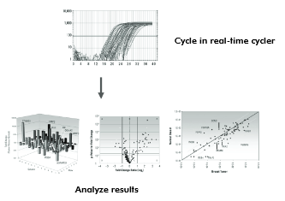
Notes:
As performed in Van et al. the OVCAR3 cells will be left untreated or treated with dsRNA or paclitaxel or the combination of both for 48 hours. Then with the Rneasy kit developed by Qiagen the total RNA would be found. After finding the total RNA using .5 micrograms of RNA is used to produce cDNA (complementarydna) which will further be used to find the expression of 84 genes related to apoptosis in our four groups. The cDNA will be mixed with a mastermix provided and then fractioned into the PCR plate where each well contains specific primers. Then the plate will be run and the results will be analyzed.

Slide 9
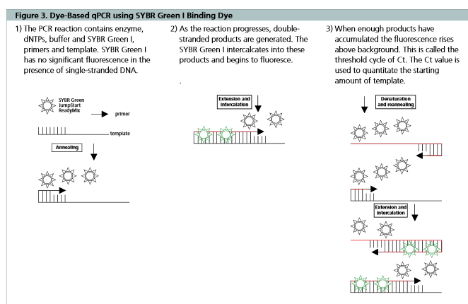

Slide 10
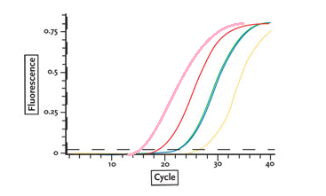
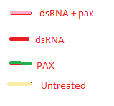
CT or Threshold cycle
value is the cycle number at which the fluorescence generated within a reaction crosses the fluorescence threshold
Notes:
The Ct or threshold cycle value is the cycle number at which the fluorescence generated within a reaction crosses the fluorescence threshold. Flourescence is the number of times the primers are replicated.

Slide 11
Results
We expect that the samples treated with combined therapeutic agents will have a higher levels of apoptotic pathway molecules or lower CT values, than the individual treated samples.
However, it may cause down regulation of anti-apoptotic proteins or cause up regulation of pro-apoptotic proteins.
Notes:
By recognizing essential pathways, patients retaining these functional pathways will benefit from the treatment.

